Slide 1
Heart Disease Severity-Level Predictor
Samya Maiti

Slide 2
Business Case/Statement
To predict the heart disease with either of the levels None , MildClass1, MildClass2, Moderate, Severe.
The detection may help plan appropriate interventions to reverse and or control the disease and bring the affected person to normal conditions or reduce potential disability thereby saving insurance and social costs.

Slide 3
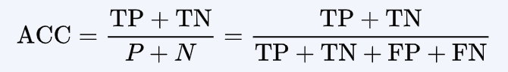
Evaluation Matrix
This is a multiclass classification problem, with evaluation matrix as Accuracy.

Slide 4
Data Model
Attr1 | Attr2 | Attr3 | Attr4 | Attr5 | ….. | …… | Target(DV)
Val_11 | Val_21 | Val_31 | Val_42 | Val_55 | ….. | …… | Class_1
Val_12 | Val_21 | Val_32 | Val_44 | Val_56 | ….. | …… | Class_2
….. | ….. | ….. | ….. | ….. | ….. | ….. | Class_3
The dataset provided is in the required format, so no alteration to dataset required.

Slide 5
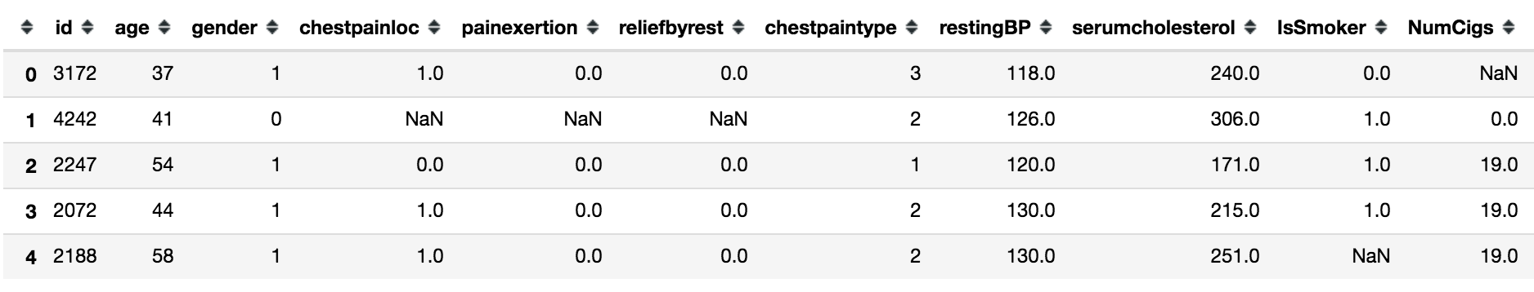
Data Analysis
The total number of records is 674 rows with 54 independent attributes and the 55th column(Severity) is the target which needs to be predicted.
…….

Slide 6
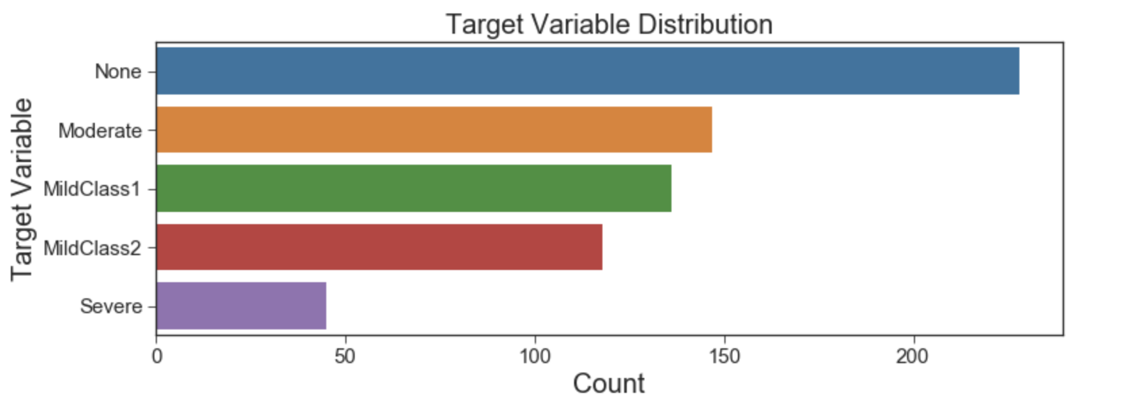
Data Analysis (cont.)

Slide 7
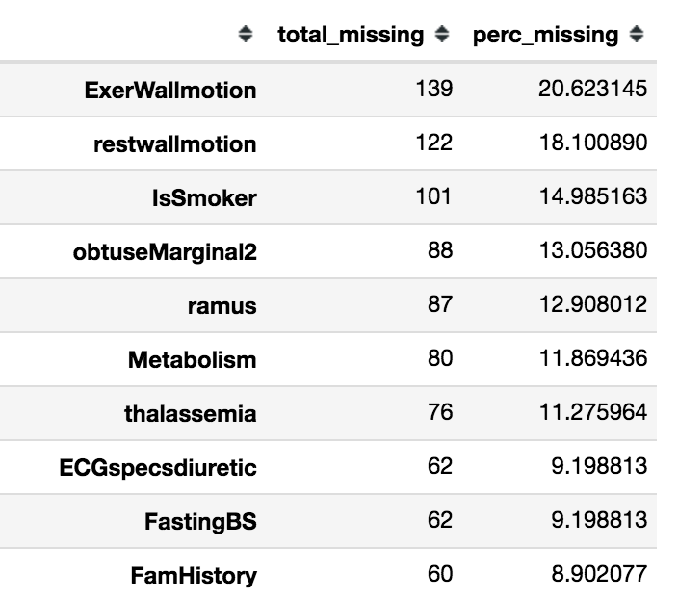
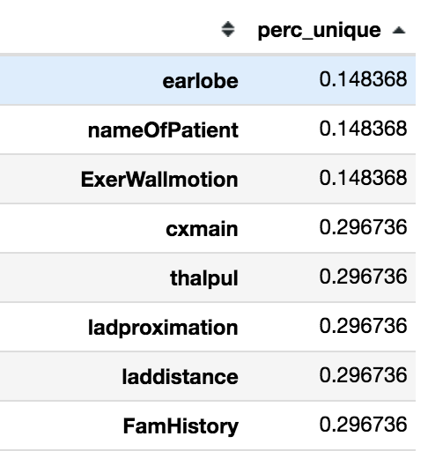
Data Analysis (cont.)
On Further analysis of few unique values,
we found the below columns have 1 value
and NAN’s. So dropping them from analysis.
ExerWallmotion
nameOfPatient
Earlobe
Also dropping id field as it not a significant candidate for analysis.
Missing Value Analysis Unique Value Analysis

Slide 8
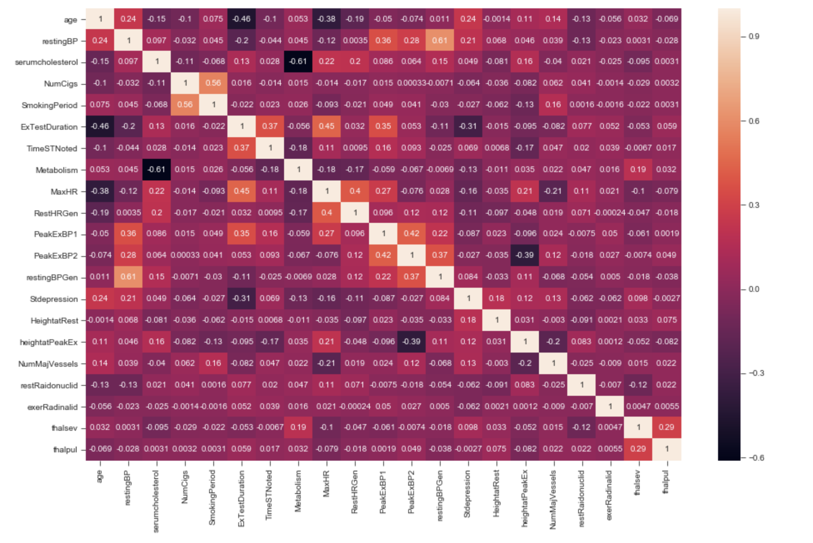
Data Analysis (cont.)
Correlation Analysis (Numeric) :
None of the numerical
attributes are highly correlated

Slide 9
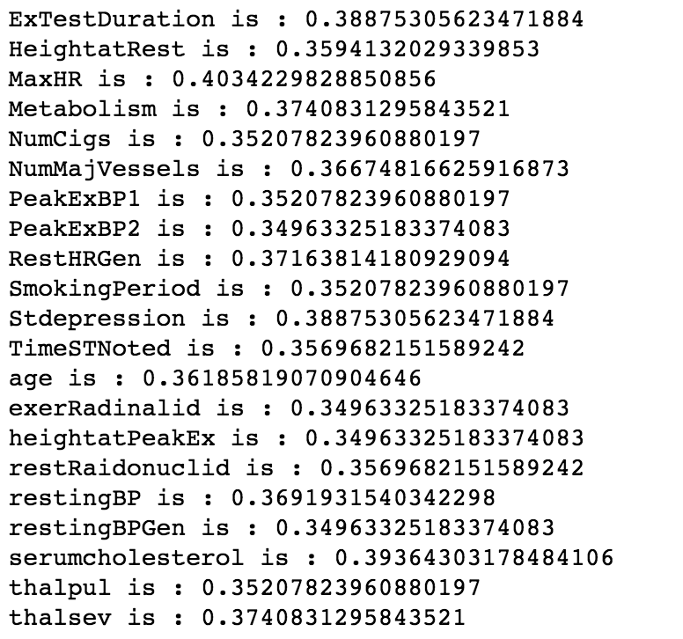
Data Analysis (cont.)
Correlation Analysis (Numeric attr to Target) :
None of the Numeric attributes are highly correlated to
Target (Logistic regression)

Slide 10
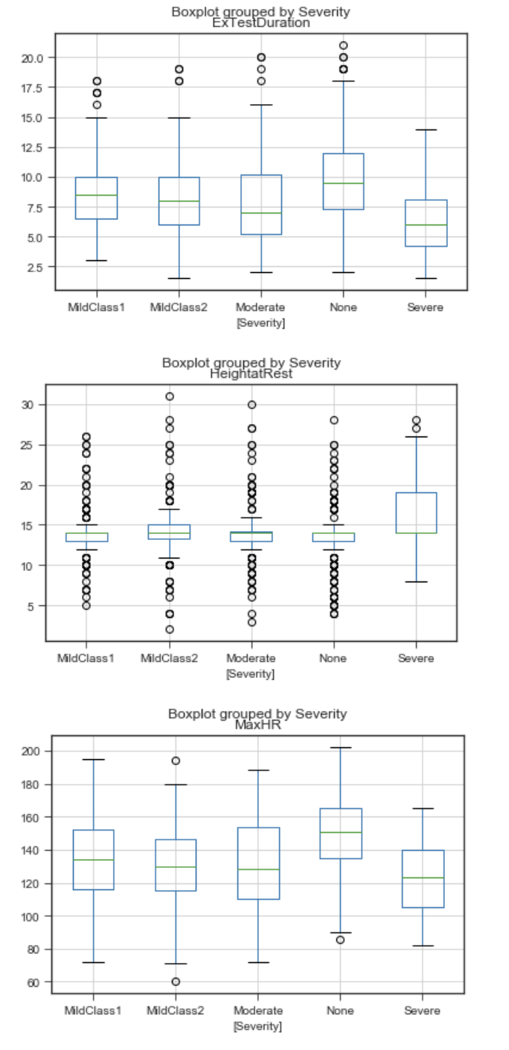
Data Analysis (cont.)
Correlation Analysis (Numeric attr to Target) :
Using Box Plot
Attribute HeightatRest identified as important feature

Slide 11
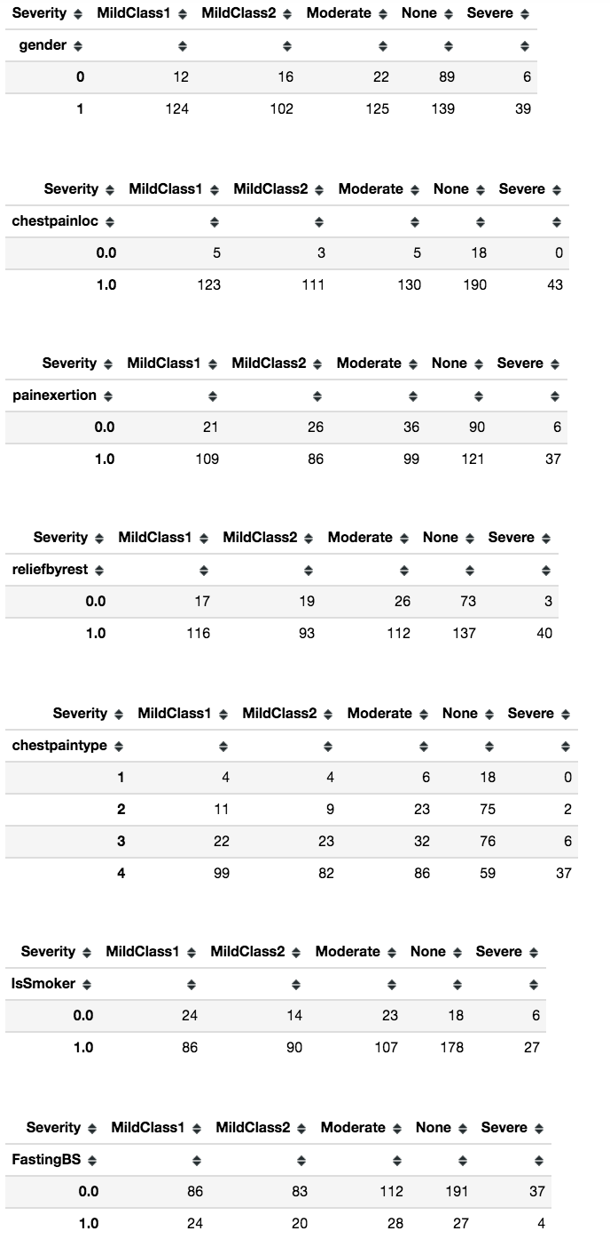
Data Analysis (cont.)
Correlation Analysis (Categorical attr to Target) :
Initially used chiSquare test, but failed analysis due to Zeros
Using crosstab : None of the Categorical attributes
are highly correlated to target
Below Attribute contribute max/important :-
Gender - male seams to be more prone to Diseased condition
chestpainloc - substernal leads to Severe condition
LeftMaintrunk - when two leads to Severe condition

Slide 12
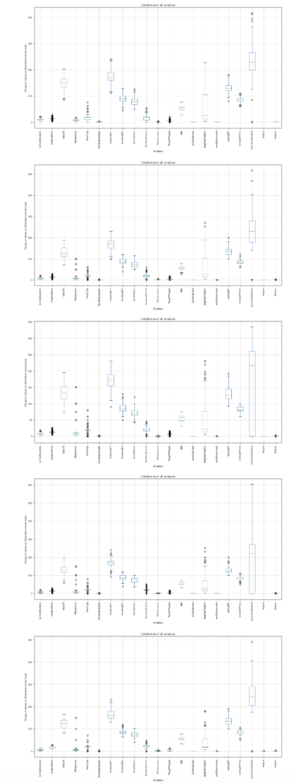
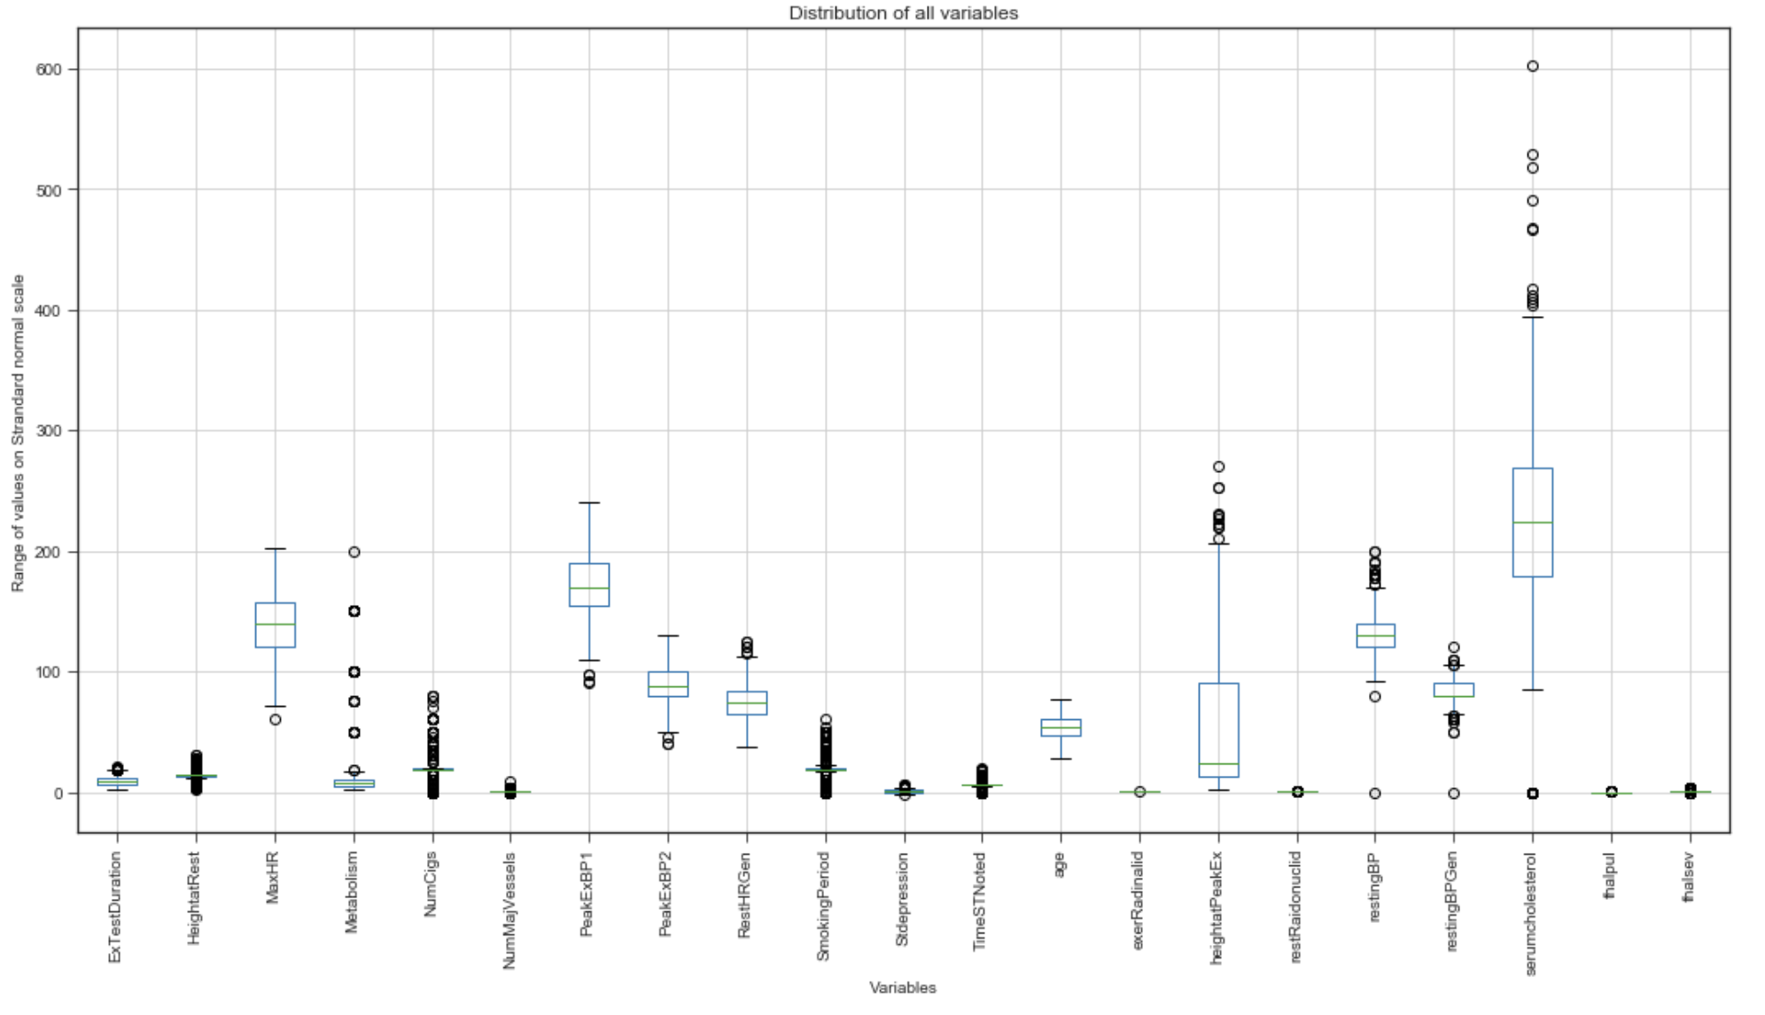
Data Analysis (cont.)
Univariate Outlier Detection
Removal of
data 5 S.D. away
from mean
(Based on Target)

Slide 13
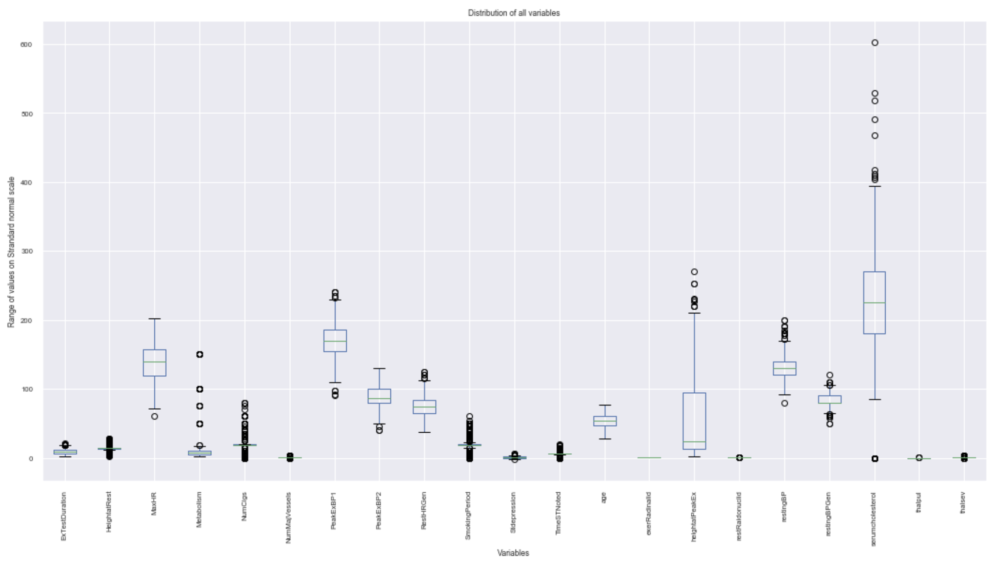
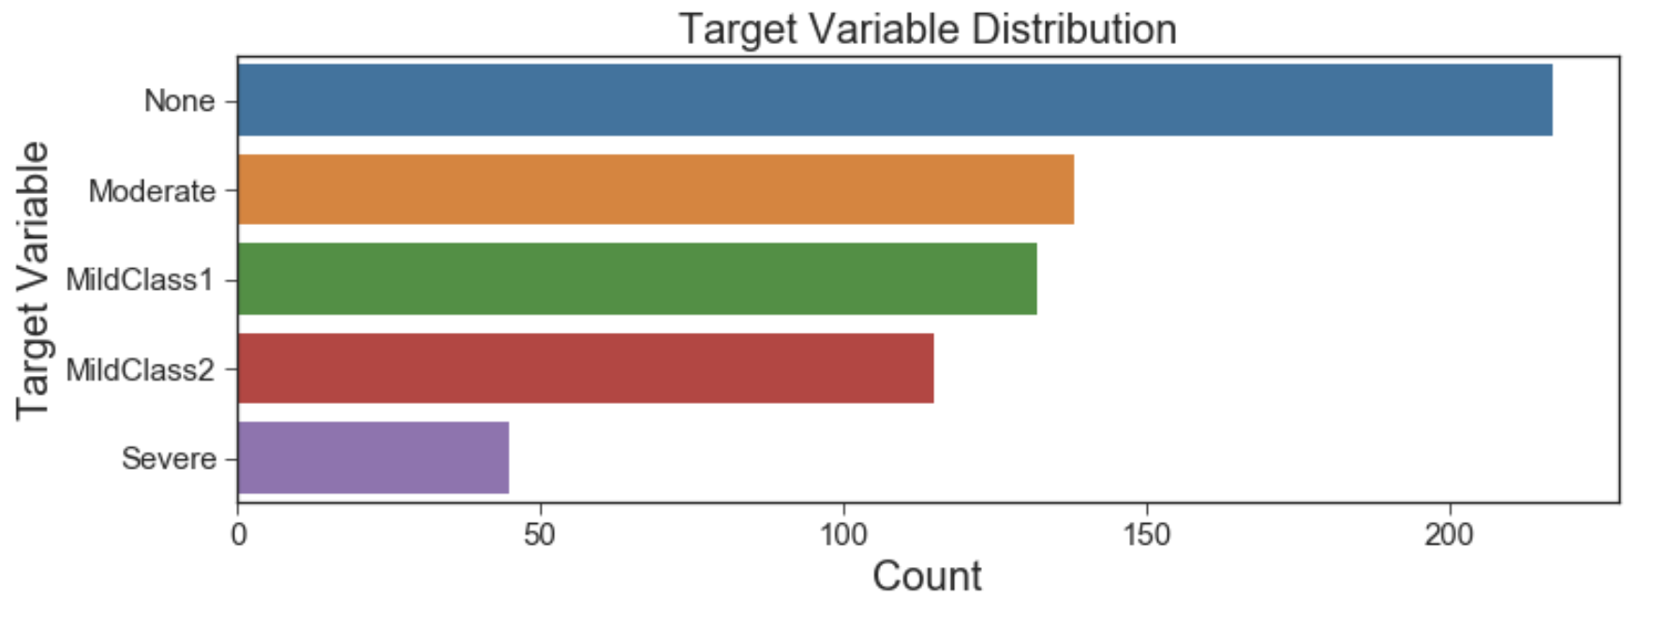
Data Analysis (cont.)
Univariate Outlier Detection

Slide 14
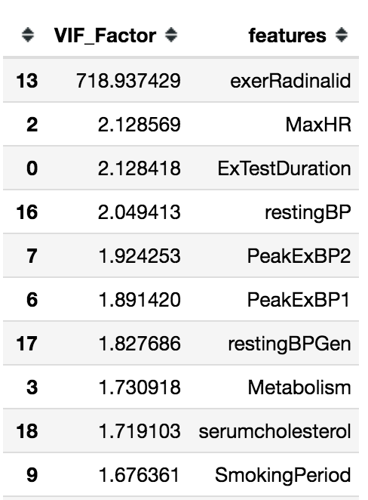
Data Analysis (cont.)
VIF calculation
Attribute exerRadinalid removed due to very high VIF

Slide 15
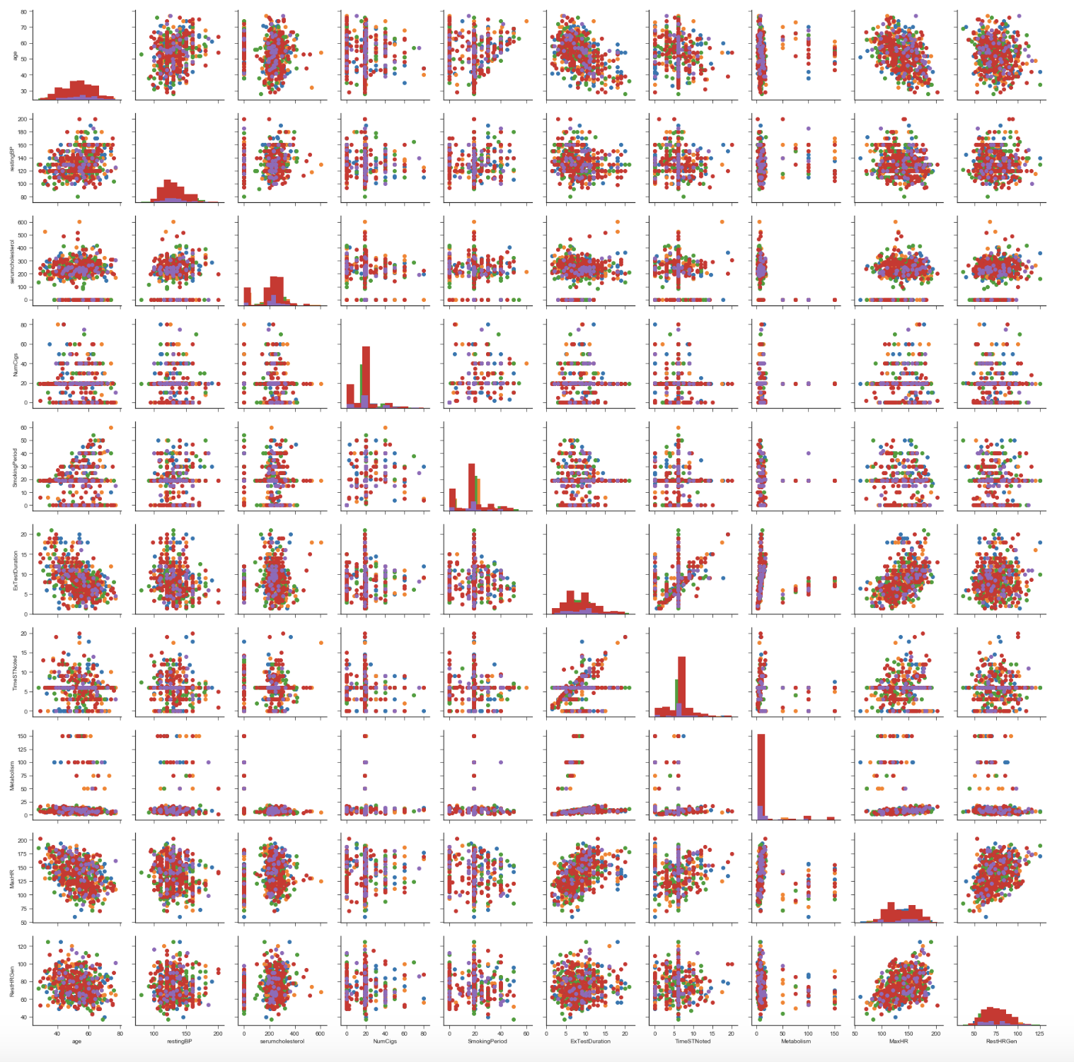
Data Analysis (cont.)
Pair Plot :
To understand segregation data points on combination of attributes.
No Segregation Identified.

Slide 16
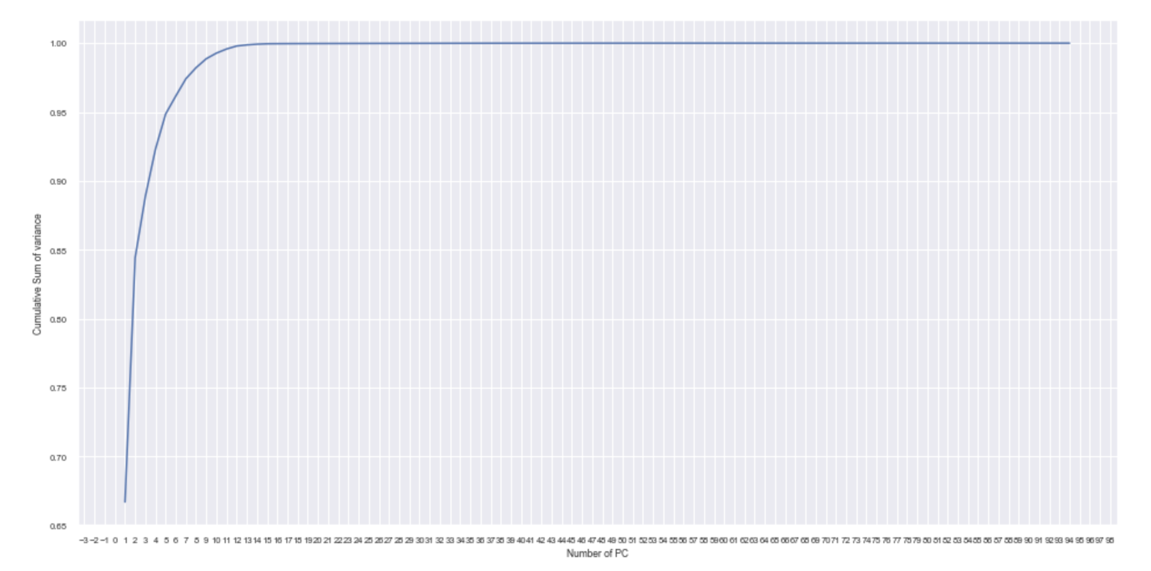
Data Analysis (cont.)
PCA
To understand if few features capture maximum variance.
98% of variance is captured by 8 PC’s

Slide 17
Data Preprocessing
Columns with only one value & NAN’s removed
ID Column dropped as it is insignificant to analysis
Univariate outliers identified and removed
Columns exceeding VIF threshold removed
TEST / TRAIN SPLIT >> 80 : 20

Slide 18
Pipeline Building
Another approach to impute missing values is by mean/mode based on target value.
Categorical Variable
SimpleImputer
(strategy='mean')
StandardScaler()
Numerical Variable
SimpleImputer
(strategy='most_frequent’)
OneHotEncoder
Classifier (Random Forest)

Slide 19
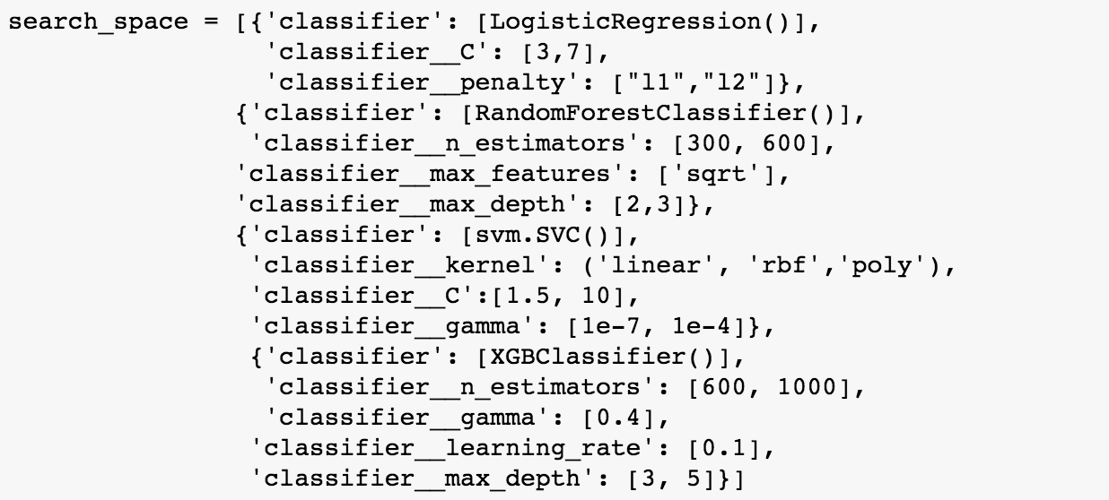
Model Building

Slide 20
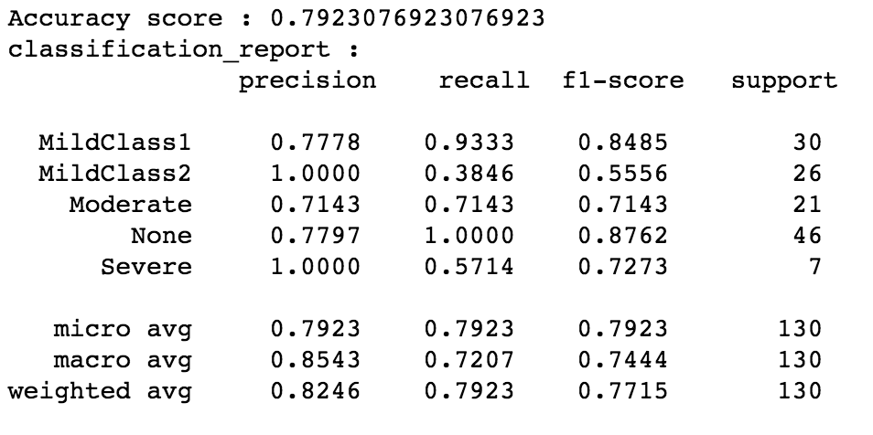
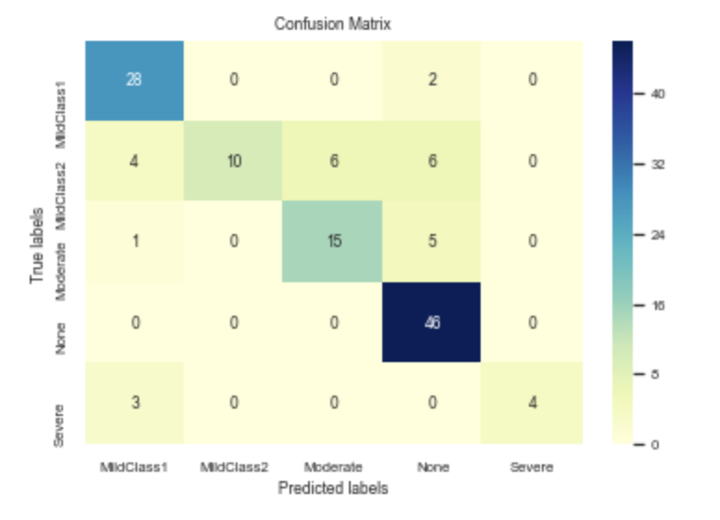
Model Building and Evaluation
Test Data Evaluation
Random Forest Classifier
Accuracy: 79.23%
Estimators: 1000
Max-feature: sqrt
Learning Rate: 0.1
Max Depth: 5

Slide 21
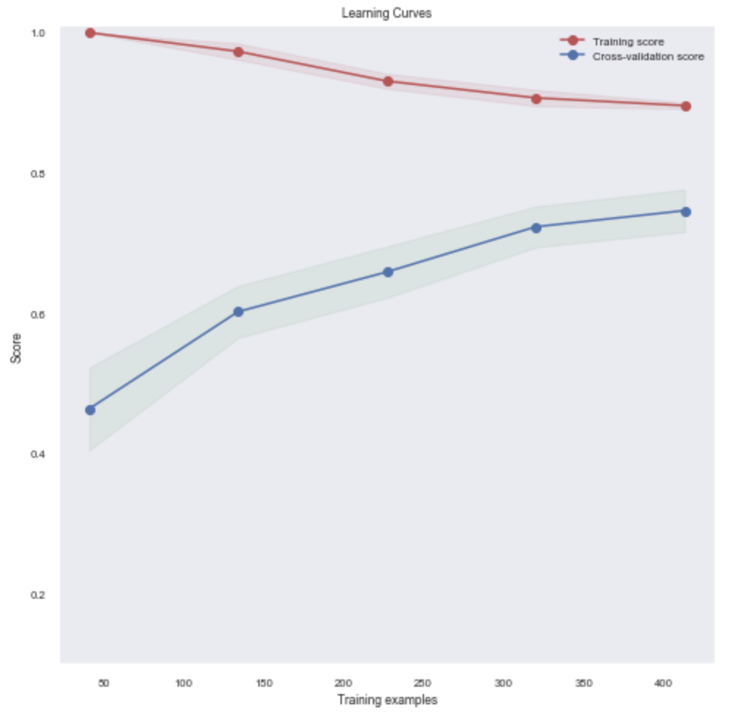
Evaluation and Post analysis
This is a high variance dataset, so a bagging classifier is a better choice.
Hence using Random Forest over XGBClassifier.
Also, as this is a medical data that needs explain ability, hence Random Forest.

Slide 22
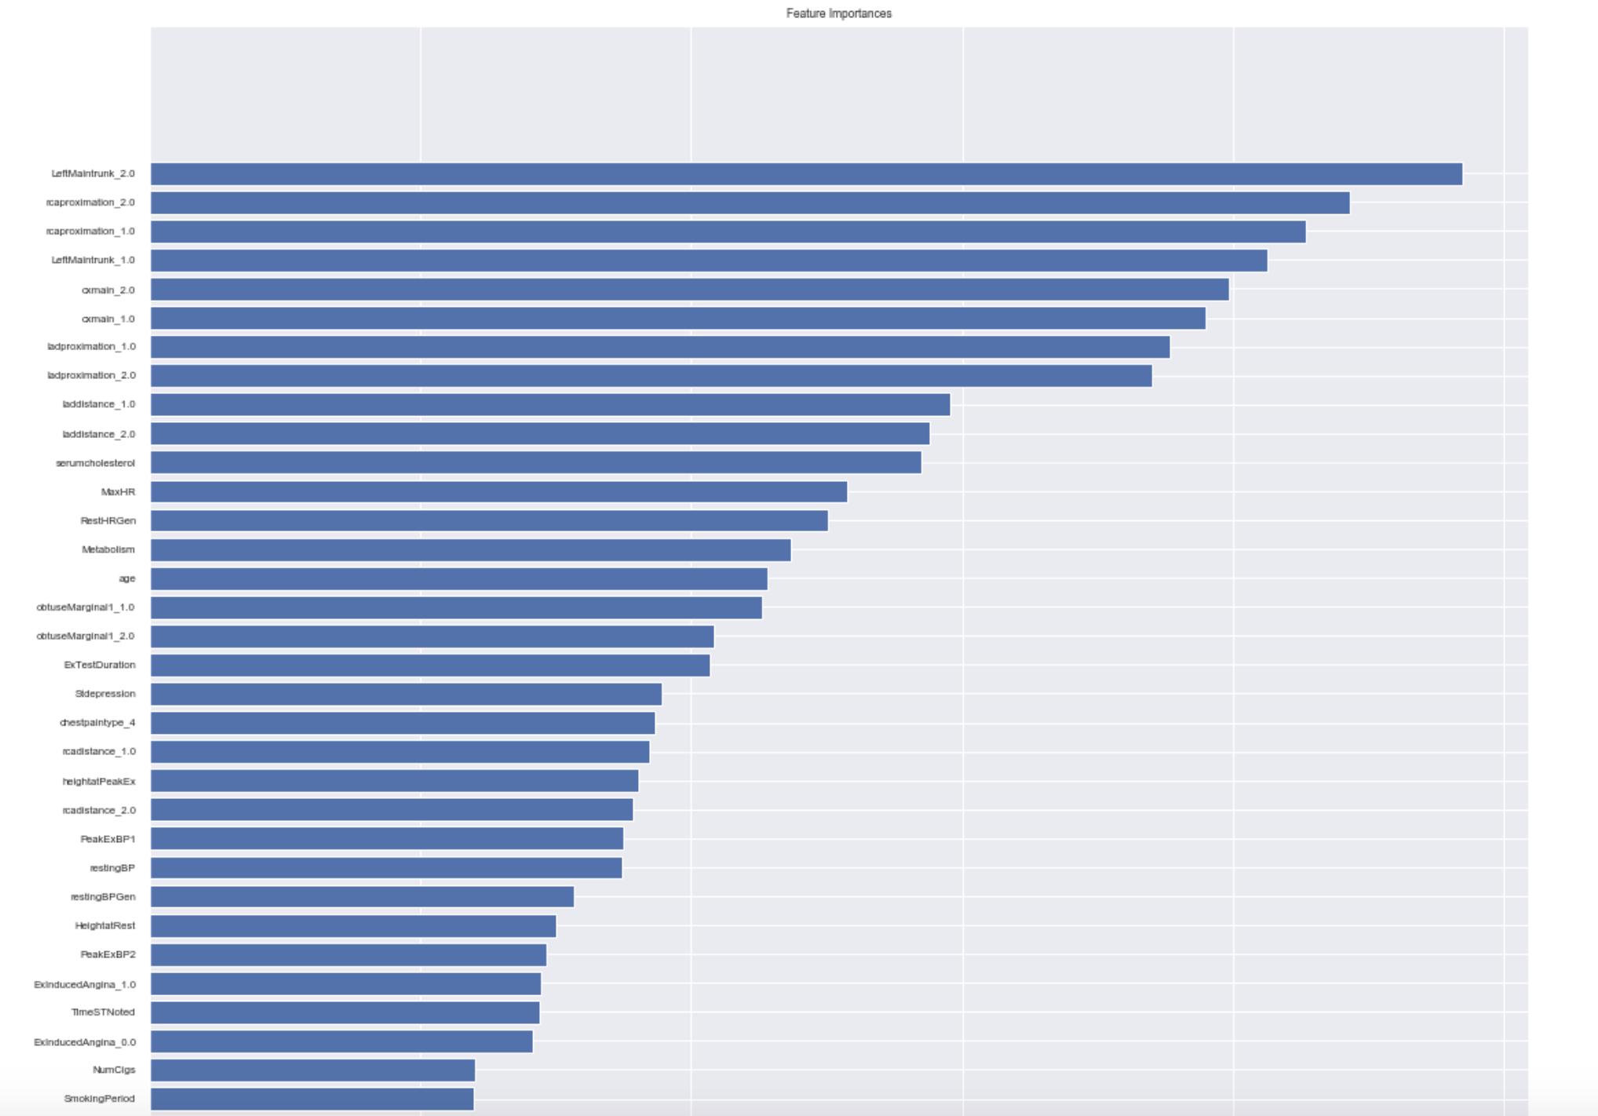
Evaluation & Post analysis(Cont.)

Slide 23
Conclusion
Accuracy of 80% on unseen data, signifies the model over all moderate performance.
Next steps:-
Based on discussion with concerned authorities, we need to probably implement a One v/s All binary implementation to counter SEVERE class.
To handle high variance problem apart from implementing a ensemble model, we may need to request more data.

Slide 24
Learnings from this Mith
Time Management.
Feature name from Pipeline not accessable.
Exploring other options:
Crosstab v/s chiSquare
Feature Importance From Pipeline v/s Create new model with Best params from grid & then get Feature Importance.

Slide 25
Q?

Slide 26
Backup

Slide 27
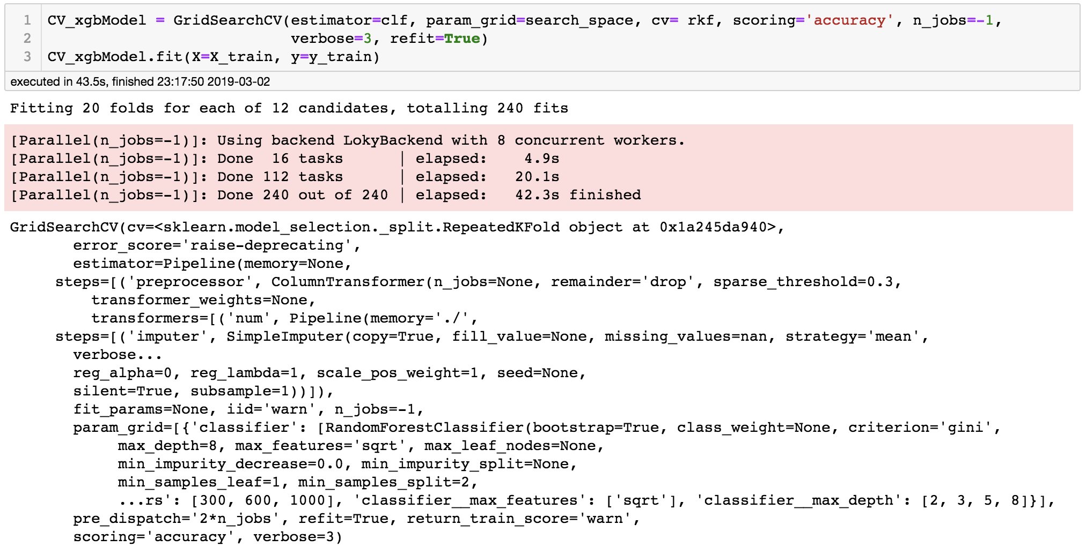
Model Building (cont.)

Slide 28
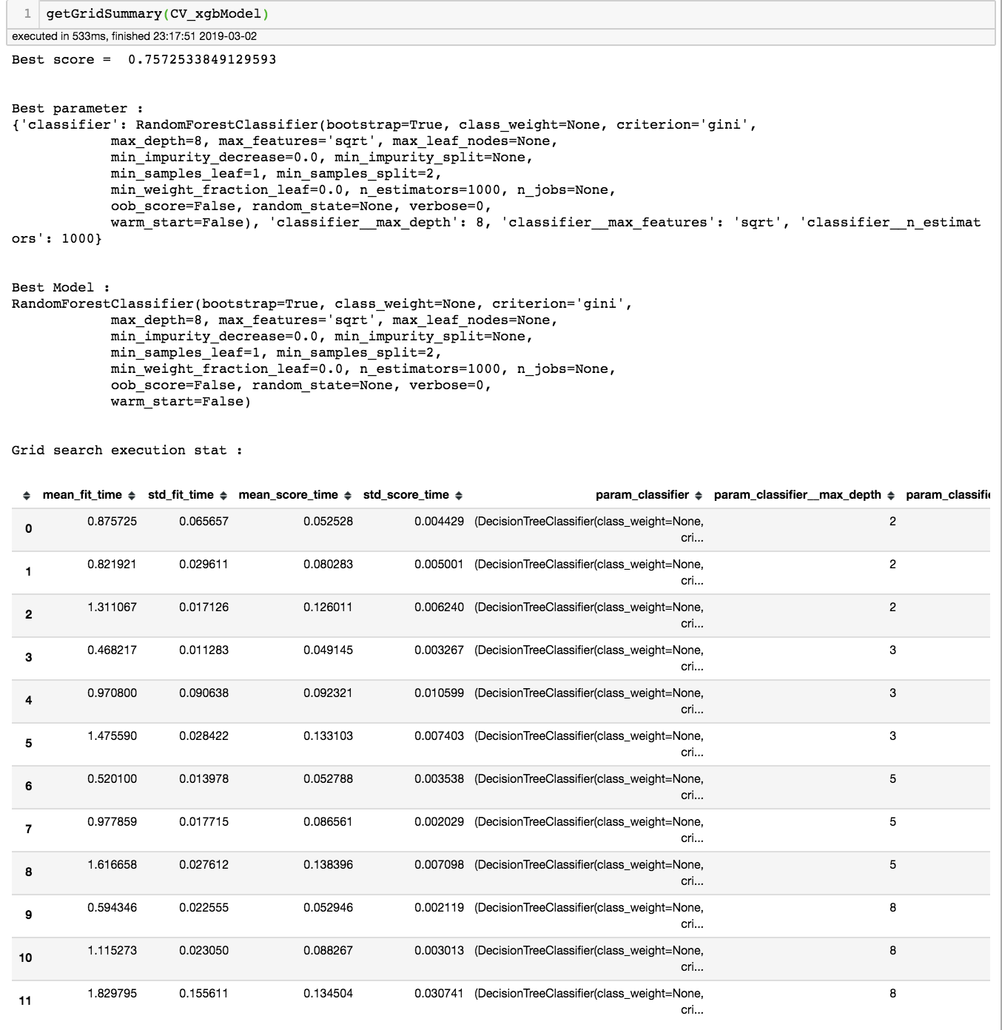
Model Building (cont.)

